Slide 1
Evaluation of Harvard Courses Through the Q Guide
Group 195 – Daniel Sun-Friedman, Grayson Martin, Muqtader Omari

Slide 2
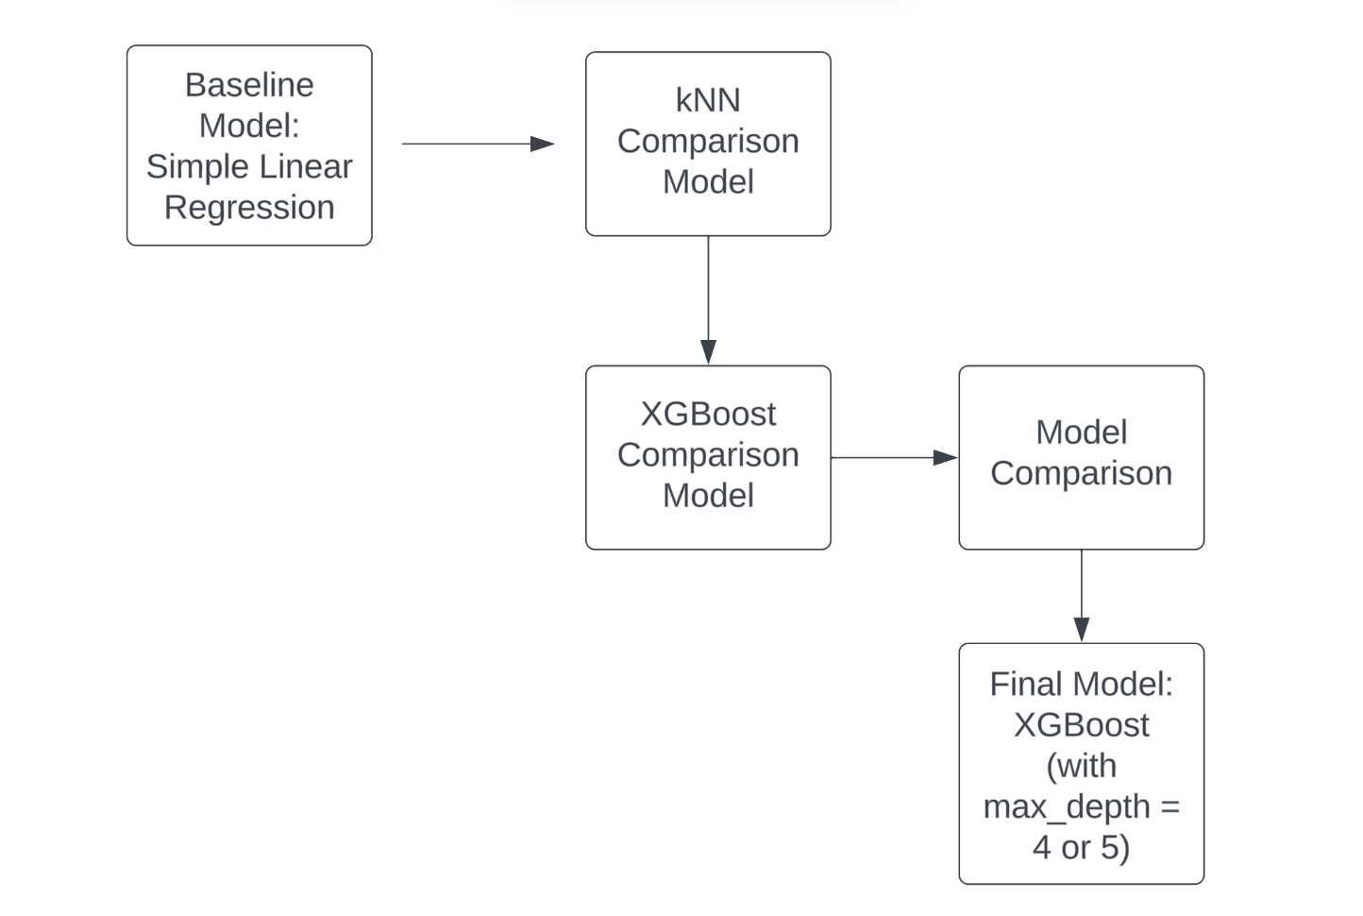
Table of Contents
Project Statement
EDA Visualizations
Modeling
Training Details
Results
Conclusions/Inferences
Future Work
Final Model Pipeline Flowchart:

Slide 3
Project Statement
Project Goal: Predict Q Guide mean overall scores for courses
Project Significance: Our project will help answer the question, “What makes a course popular?”
Project Relevance: Students want to take good courses, professors want to make good courses

Slide 4
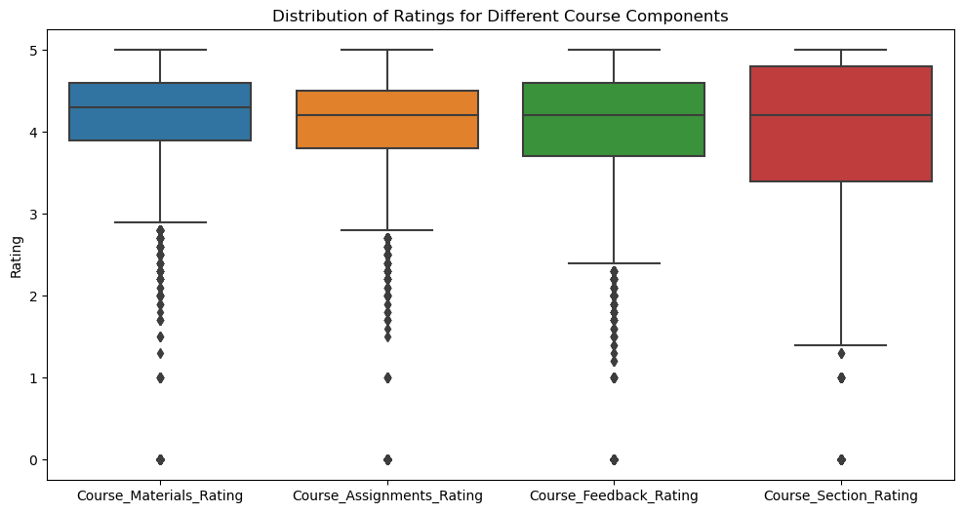
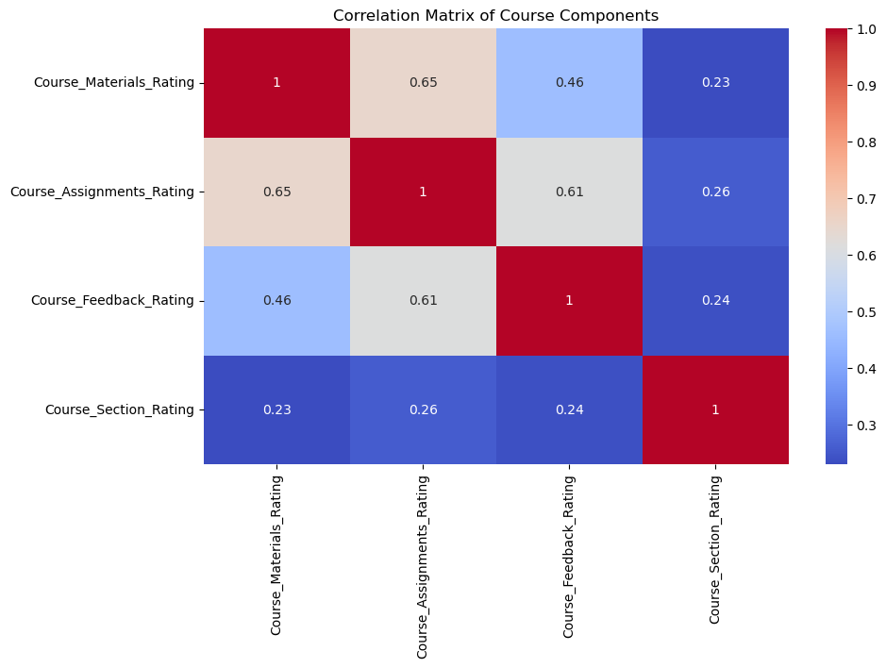
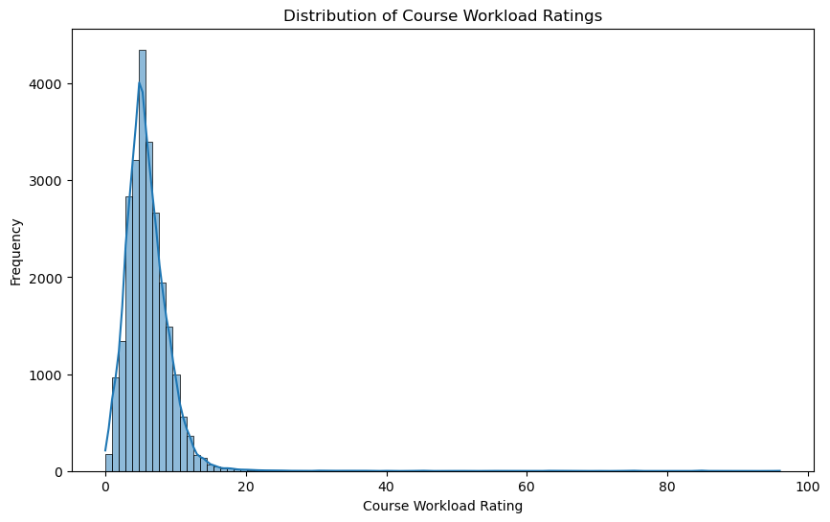
EDA Visualizations

Slide 5
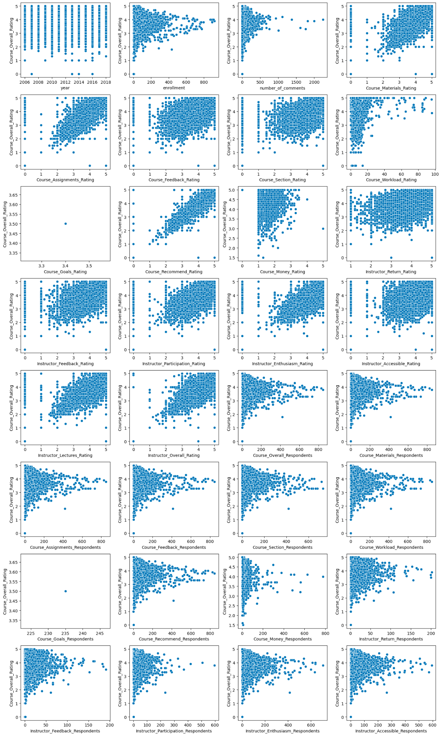
EDA Visualizations
Legend:
Red: Positive correlation w/ response variable
Blue: One observation, irrelevant
Brown: Likely collinear w/ other predictors

Slide 6
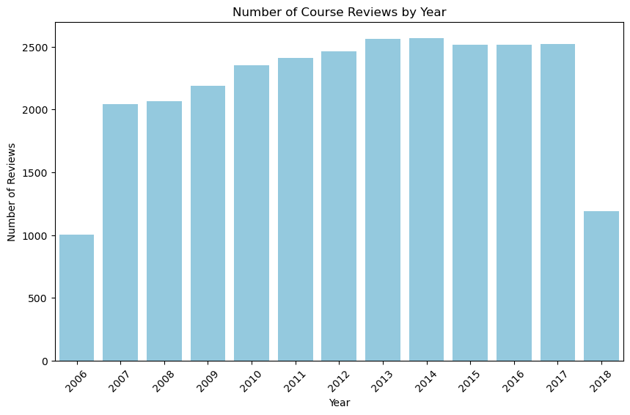
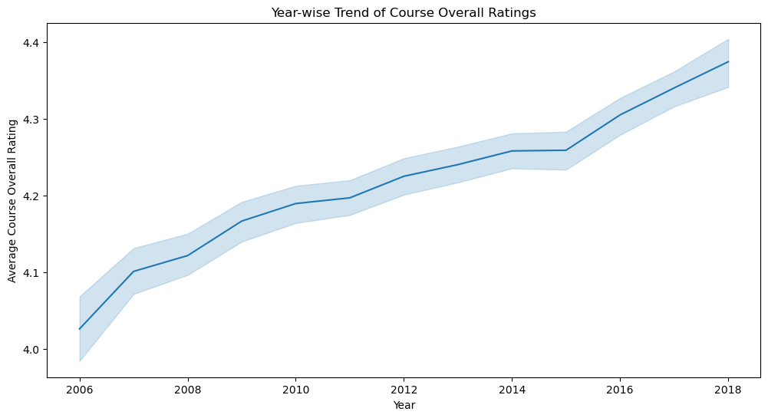
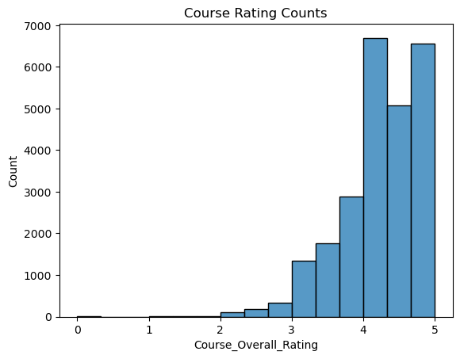
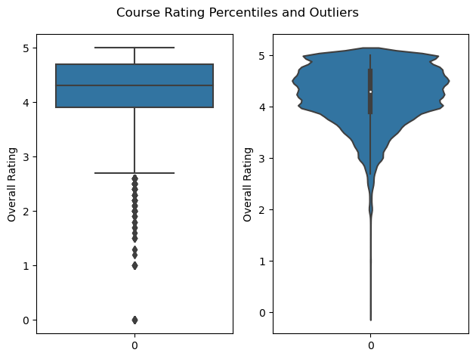
EDA Visualizations

Slide 7
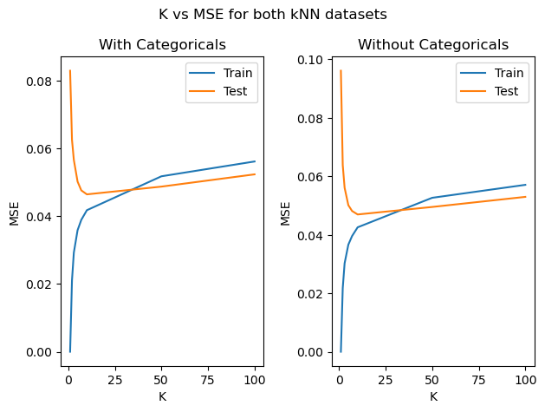
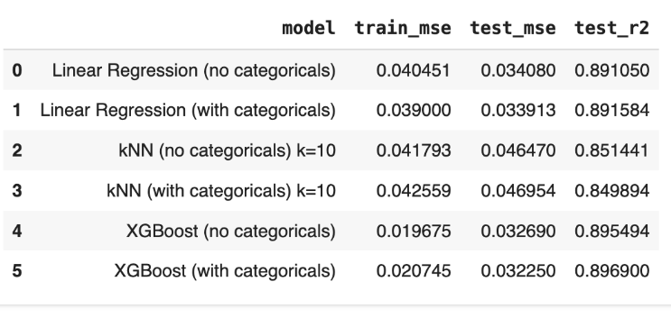
Modeling
Models with categoricals (highlighted in red) perform better
Notes:
Two datasets - numeric only and categoricals
Linear regression - baseline, basic, interpretable
kNN - more complex but still interpretable, we tuned k as shown on the graph on the left
XGBoost - less interpretable, but potentially more accurate as an ensemble model

Slide 8
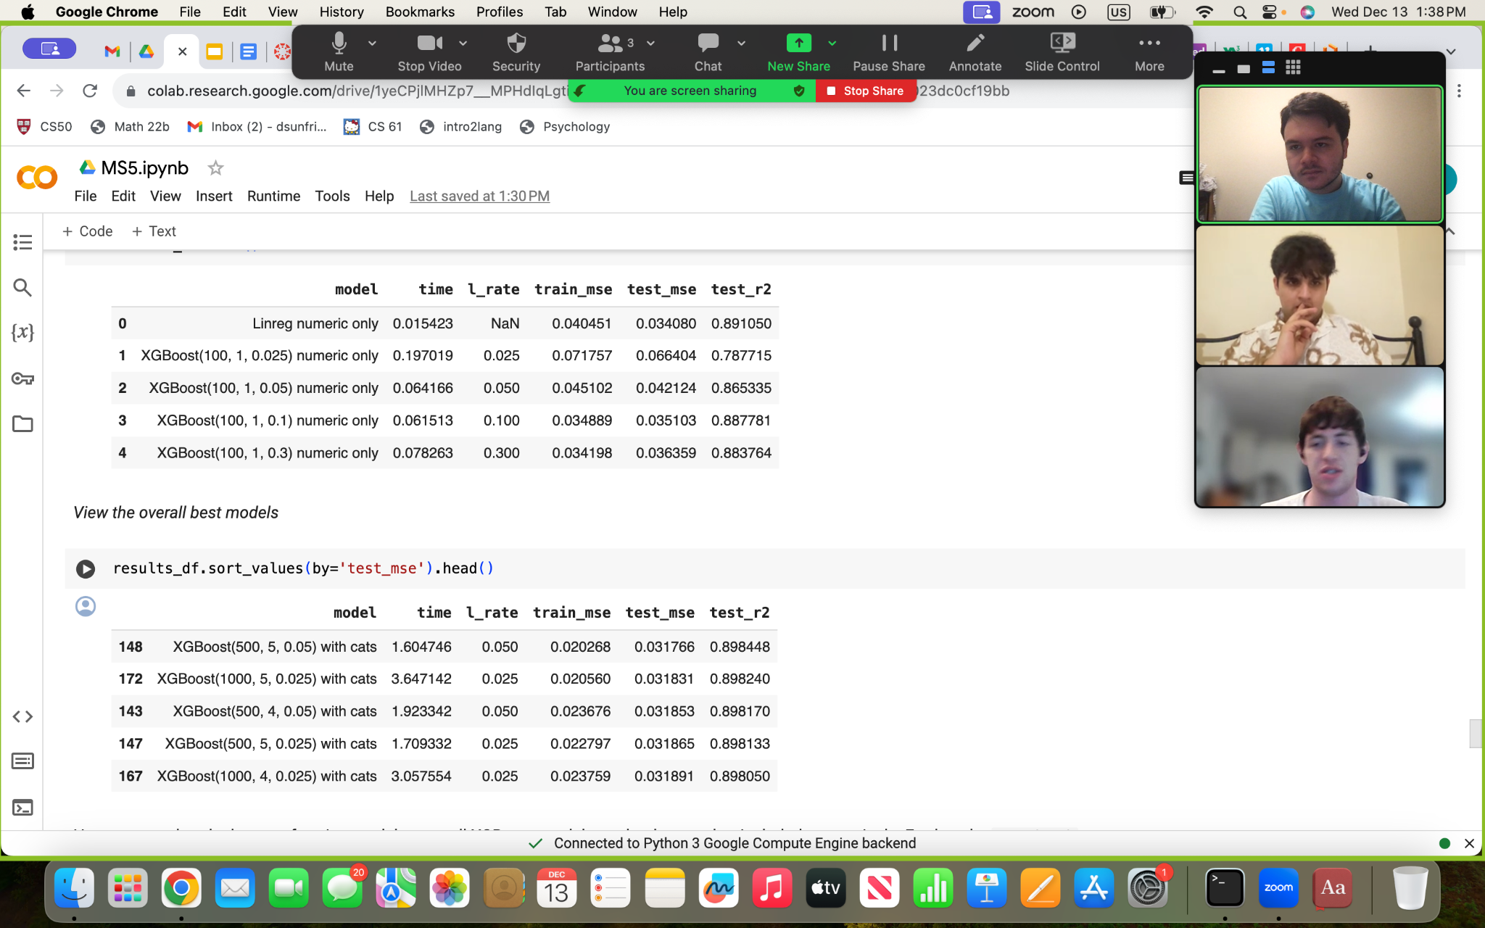
Training Details
Generated 2 datasets, one numeric and one with numeric and categoricals
Ran baseline linear regression on each
Optimized our XGBoost comparison model by trying different numbers of weak learners, depth of weak learners, and learning rates
Hyperparameters
Notes:
Optimized XGBoost comparison model by tuning hyperparameters number of weak learners, depth of weak learner trees, and ensemble learning rate and looking at MSE, R2, and time
Dataframe of results shown on the left, with the top 5 performing models shown on the right
We see that the best performing models were all XGBoost models using categoricals with an intermediate number of base learners, more complex base learners, and small learning rates

Slide 9
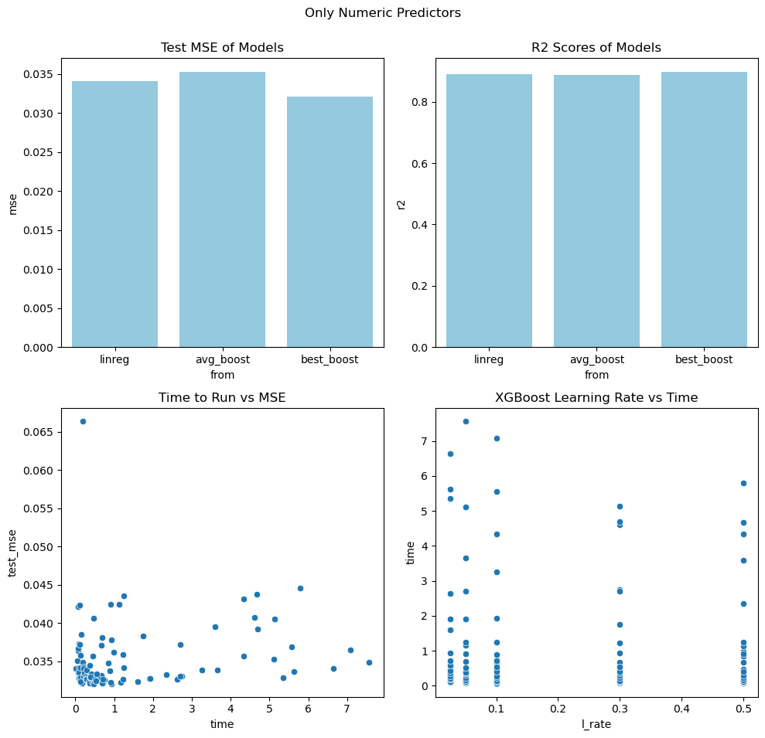
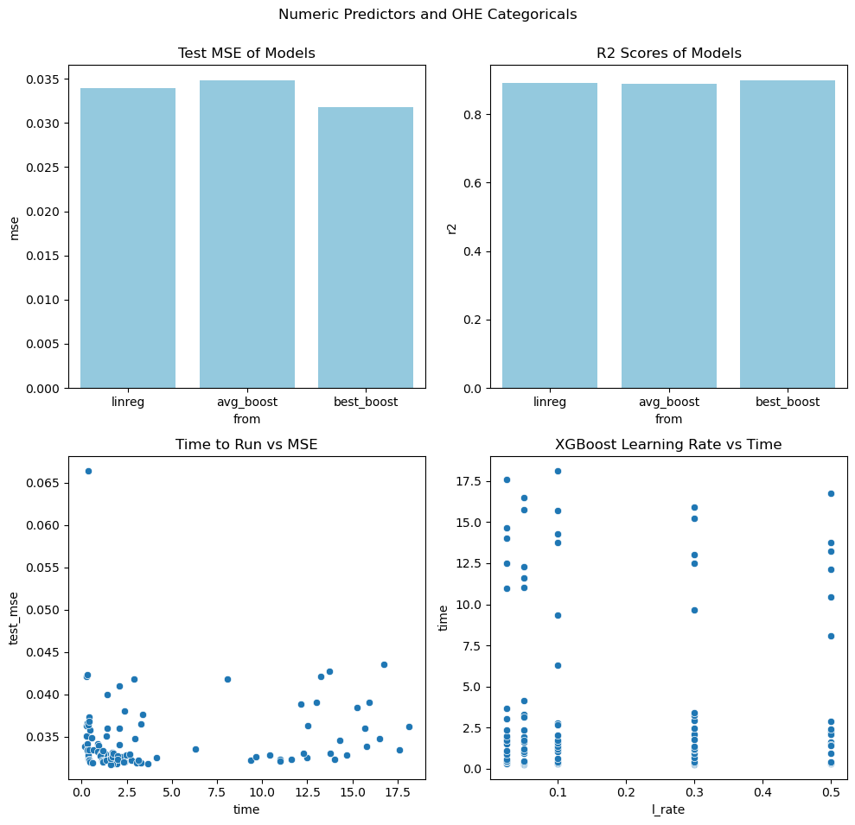
Results

Slide 10
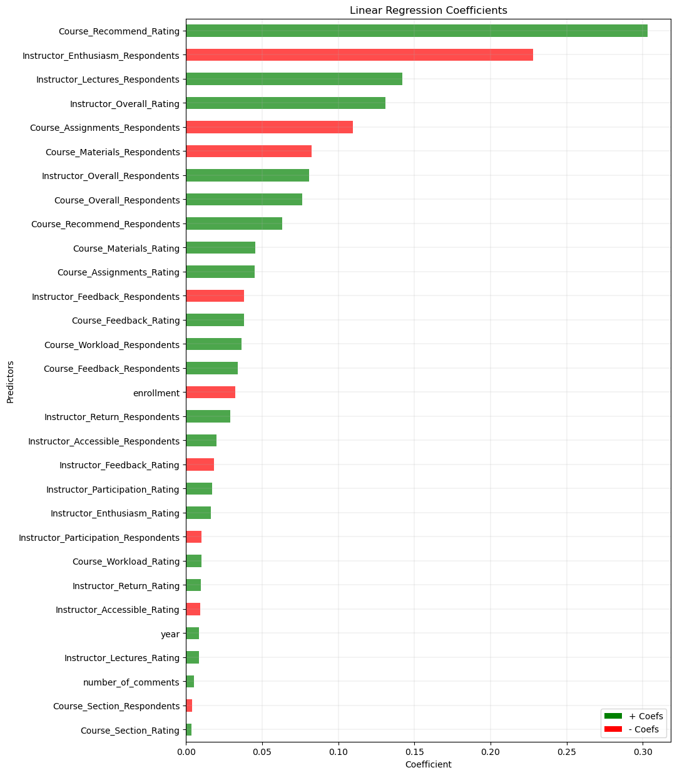
Conclusion/Inferences
XGBoost (final model) did better than linear regression (baseline model)
Importance of predictors less relevant in final model
Importance of predictors in baseline model shown on right

Slide 11
Future Work
Ratings from specific students rather than course averages
More rigorous methods of quantifying various course factors
Methods of causal inference (randomization tests, A/B testing)

Slide 12
Thank You!

